Slide 1
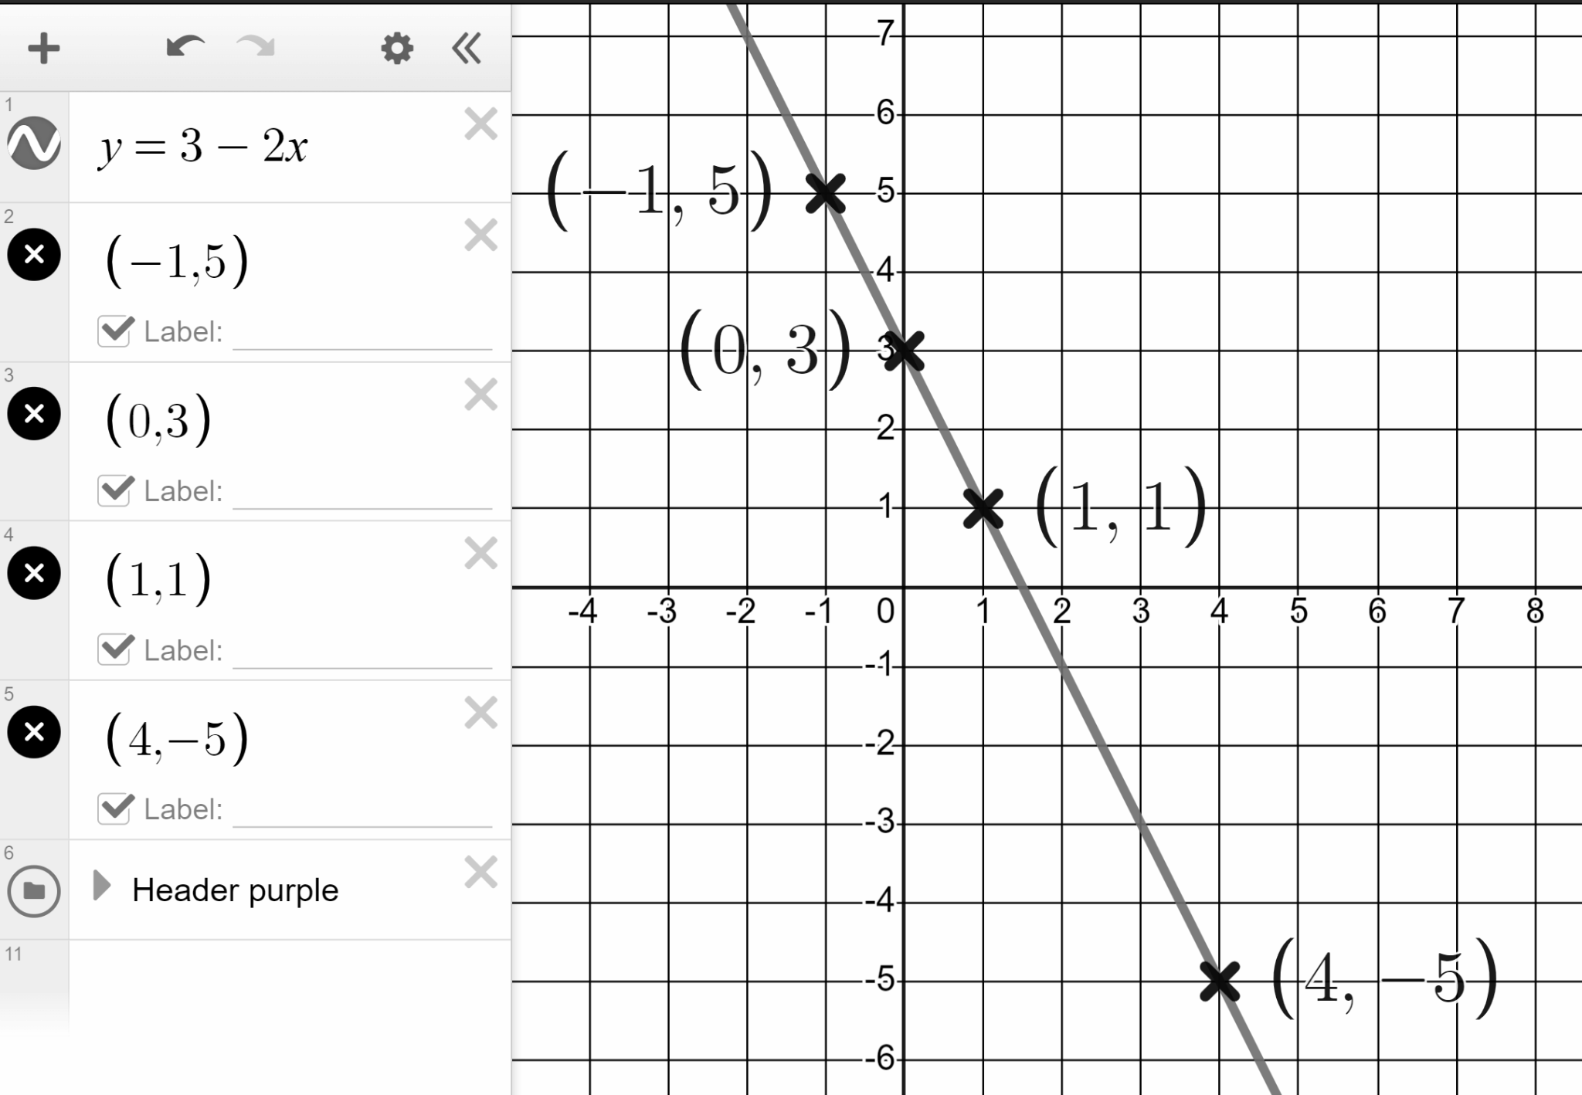
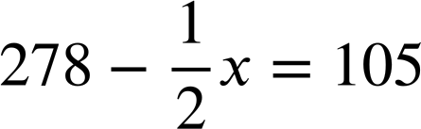
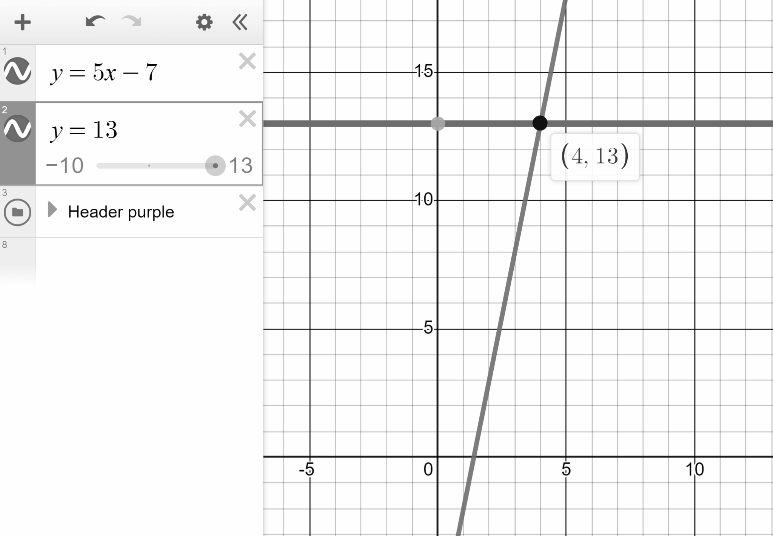
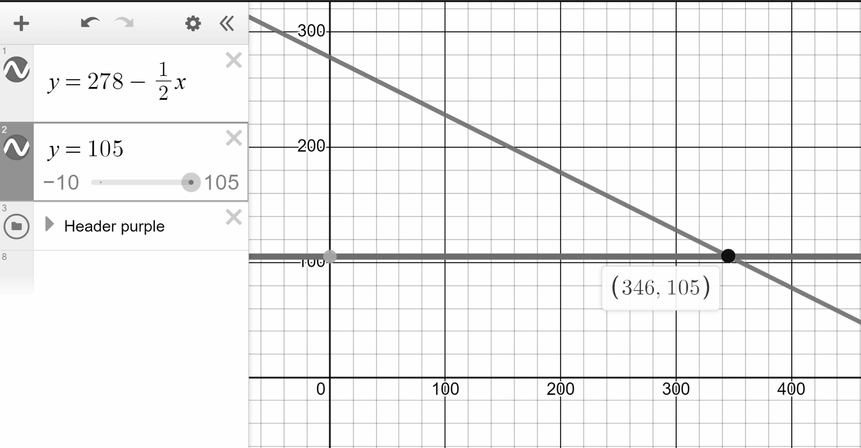
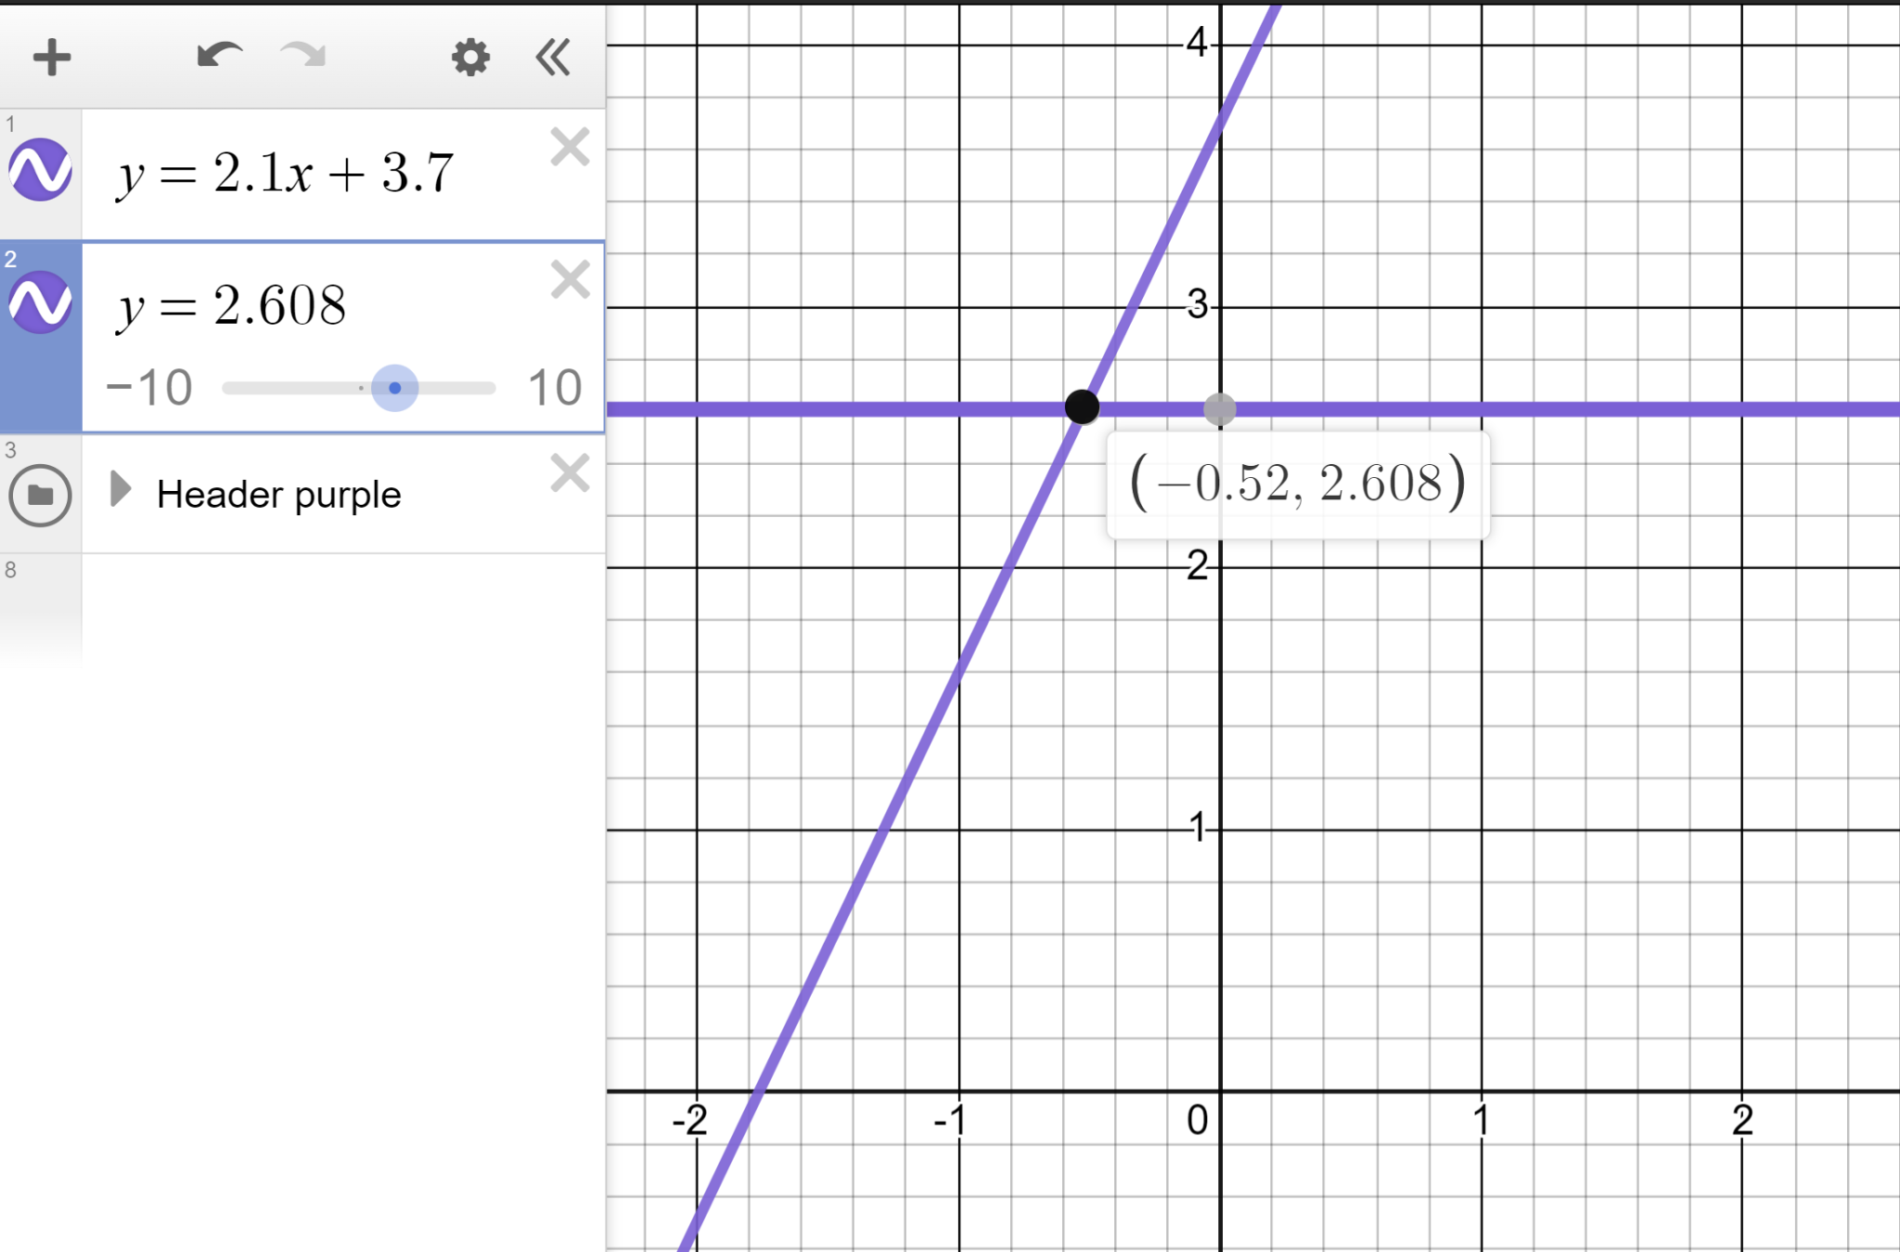
Solving linear equations graphically using technology
Task A: Solving equations with unknowns one side
1) Draw the line y = 3 − 2x and use it to solve the below equations.
a)
3 − 2x = 1
x = 1
b)
3 − 2x = −5
x = 4
c)
3 − 2x = 5
x = −1
d)
3 − 2x = 3
x = 0
2) Draw two lines for each to find the solutions to these equations:
a)
5x − 7 = 13
b)
c)
2.1x + 3.7 = 2.608
x = 4
x = 346
x = −0.52

Slide 2
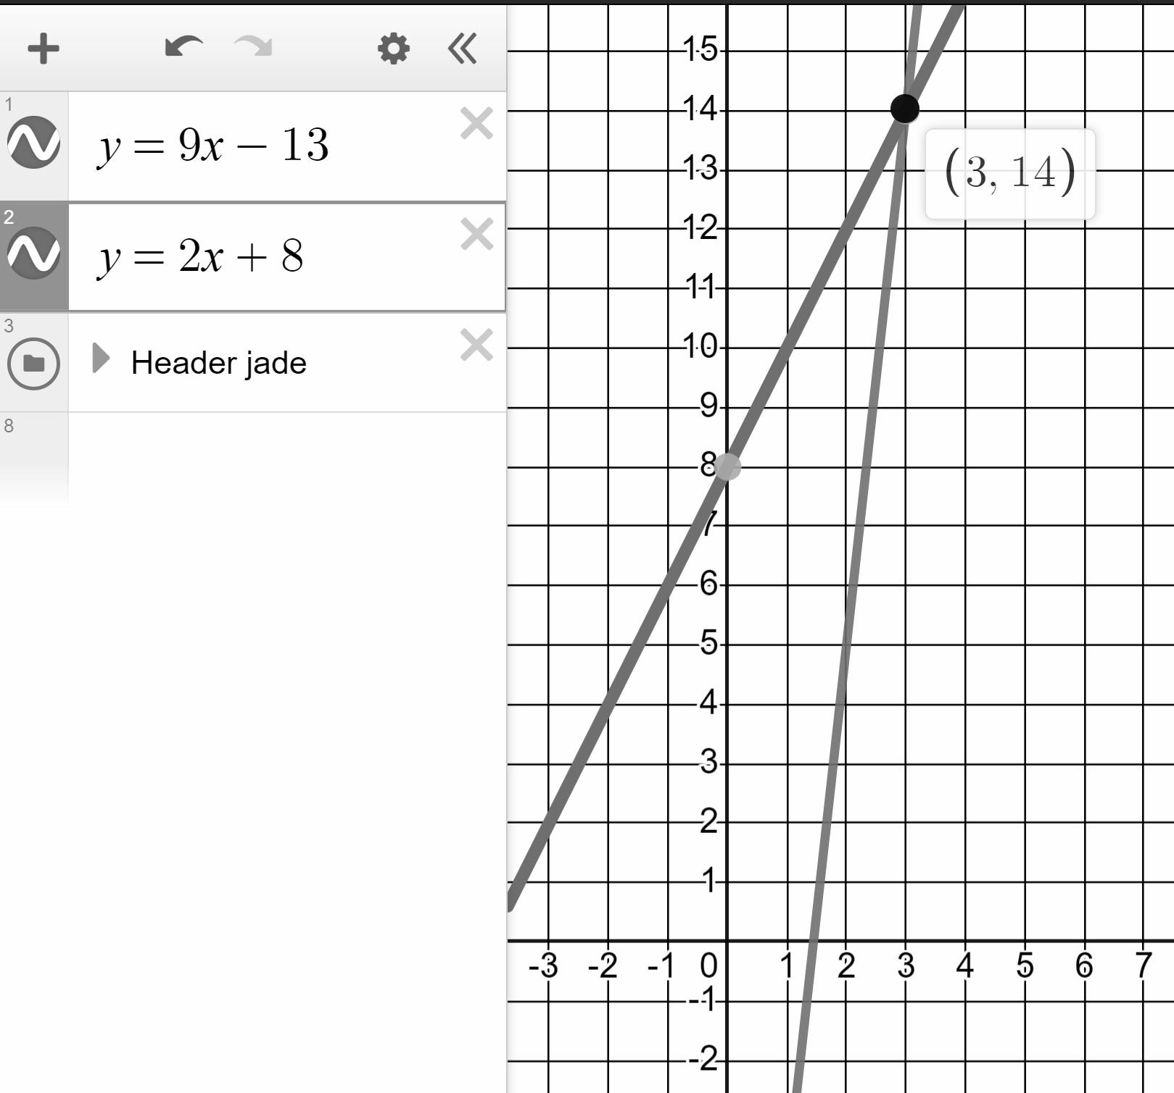
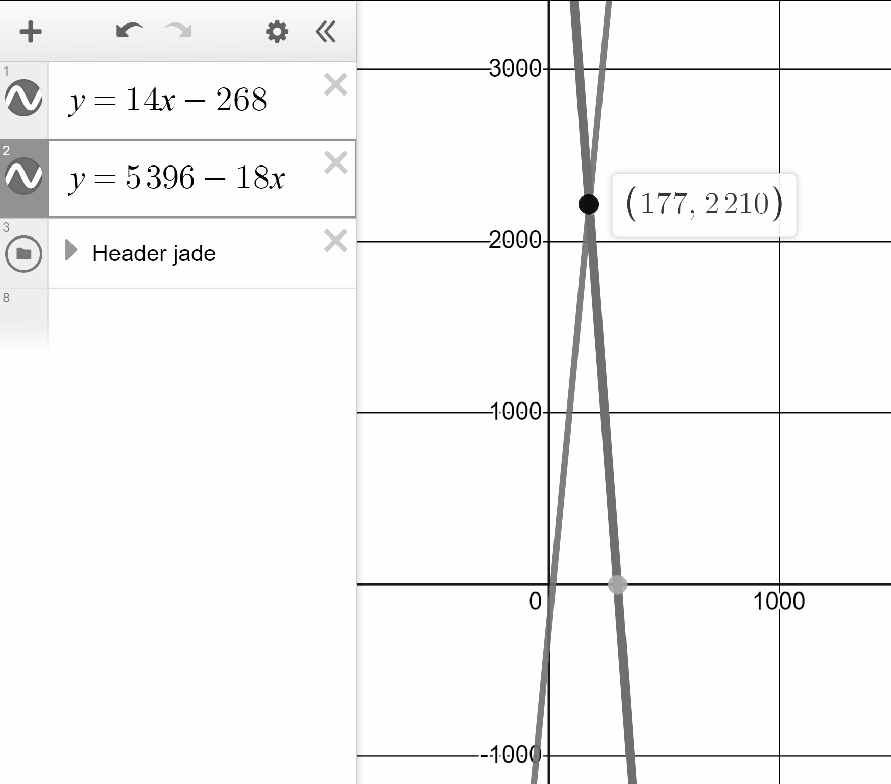
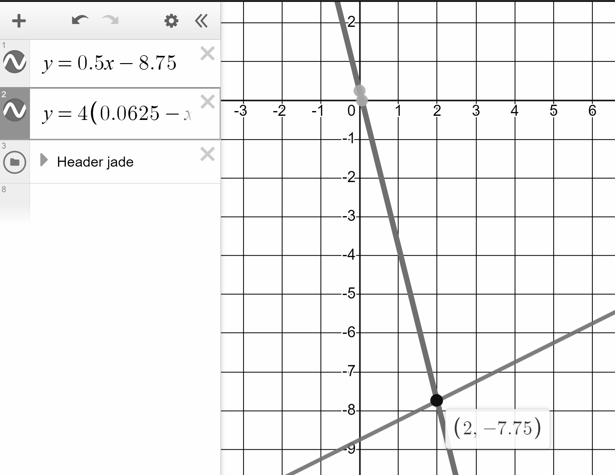
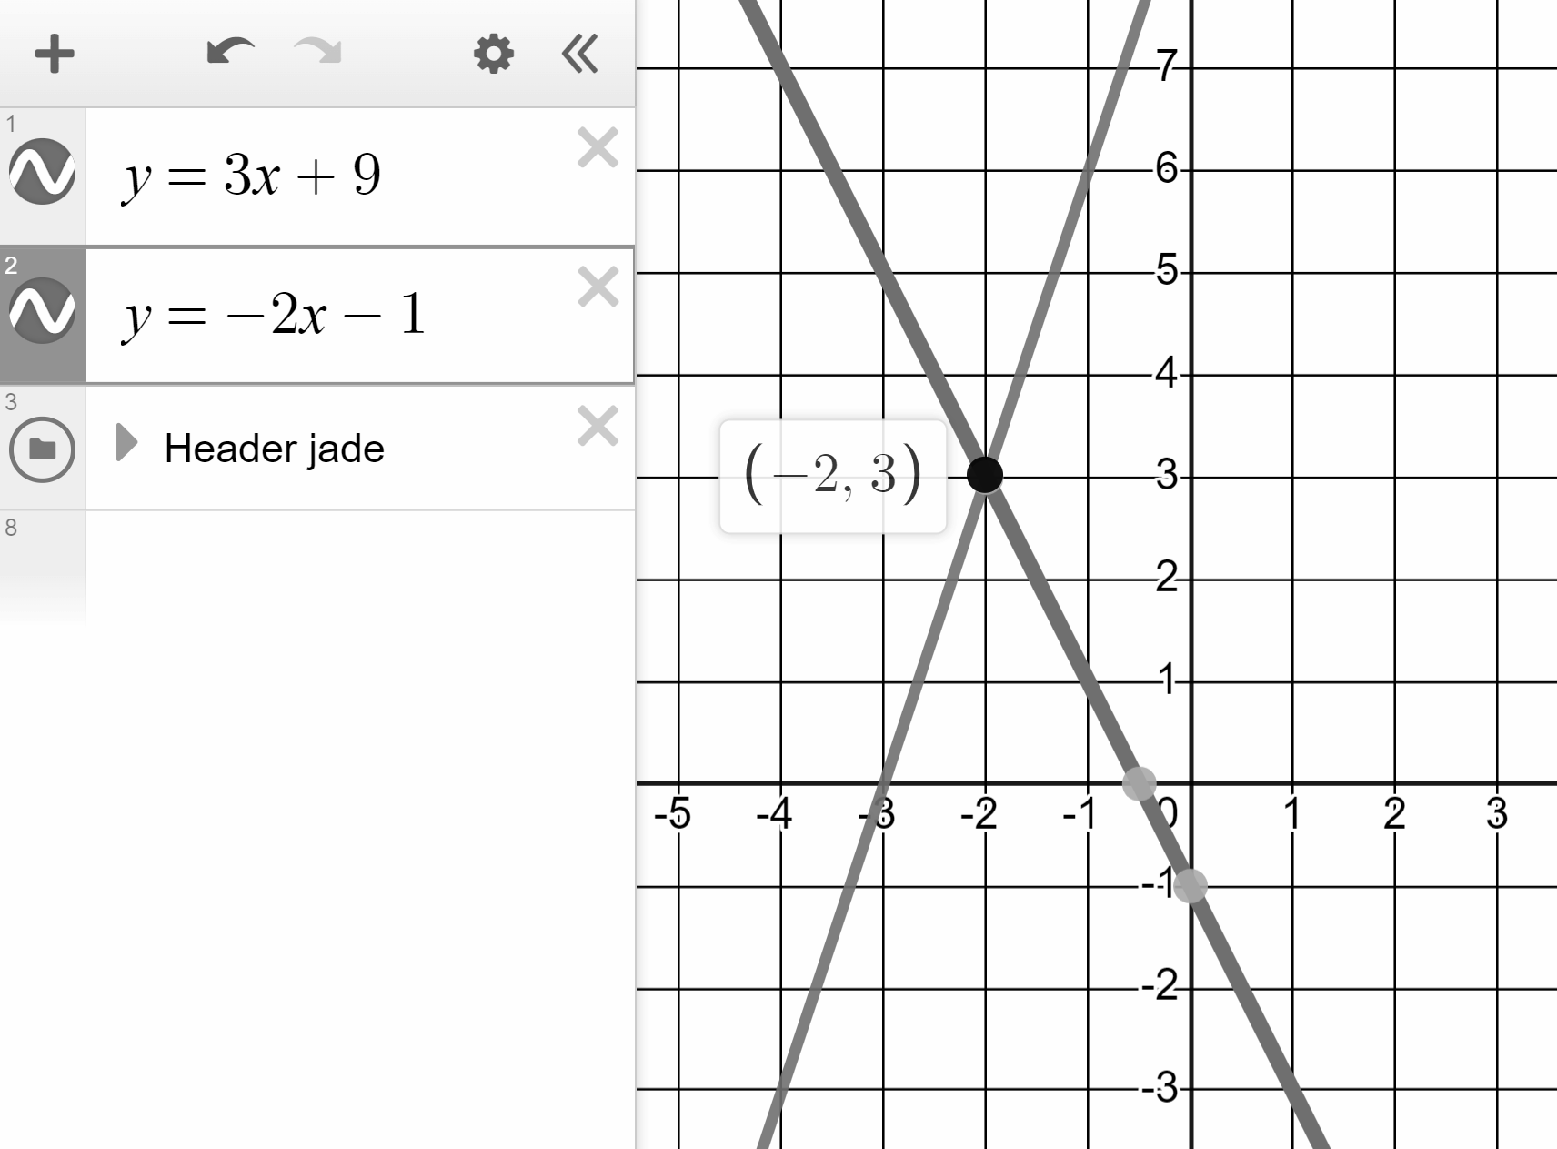

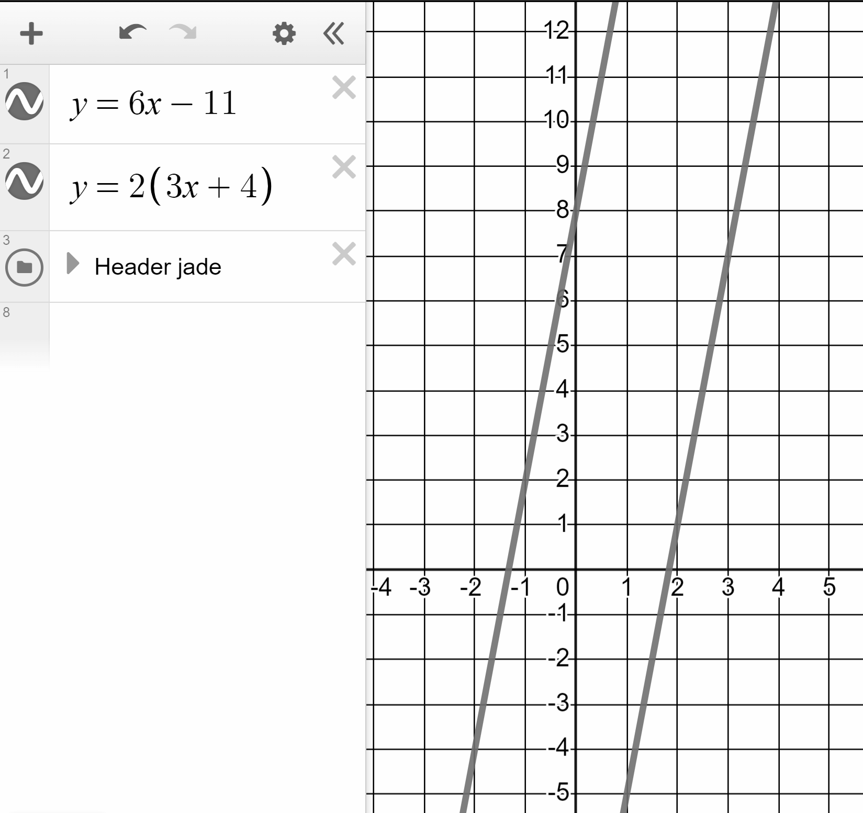
Solving linear equations graphically using technology
Task B: Solving equations with unknowns on both sides
1) Plot pairs of lines and find the intersections to solve the below equations:
a)
9x − 13 = 2x + 8
b)
14x − 268 = 5396 − 18x
c)
0.5x − 8.75 = 4(0.0625 − x)
Intersect at (3, 14) therefore solution is x = 3
Intersect at (177, 2210) therefore solution is x = 177
Intersect at (2, −7.75) therefore solution is x = 2
2) Alex says this graph shows that the solution to the equation
3x + 9 = −2x − 1 is x = 3
Alex is wrong.
Identify the correct solution and write a sentence explaining Alex’s error to him.
You might have written:
x = −2 is the solution
3 is the value of both expressions when x = −2
3) One of the below equations has no solution.
Identify which one it is and show why it has no solution.
a)
8 − 3x = 3x + 2
Different gradients therefore intersection and a solution.
b)
11x − 25 = 25x + 7
Different gradients therefore intersection and a solution.
c)
6x − 11 = 2(3x + 4)
6x − 11 = 6x + 8
Same gradient. No intersection, no solution.
Mathematics in Education and Industry.
v2.3

